Slide 1



MEDICINE WAREHOUSE
Presented by: Rehab Hashem

Slide 2

INTRODUCTION
The medicine warehouse is a specialized facility designed for the storage, management, and distribution of pharmaceutical products. It plays a critical role in ensuring that medicines are stored in optimal conditions and are readily available for distribution to healthcare providers, pharmacies, hospitals, and other end-users.

Slide 3

PROJECT OBJECTIVE
01
02
The goal of this project is to analysis the medicine warehouse to improve efficiency ,identify performance and how transaction effectes of the revenue ,Target achivement 2.5 % in every Quarter and minimizing risk through data-driven insights .
03
04

Slide 4
DATASET FEATURES
Generic Name
Brand Name
Diseases med use
Company name
Delivery plant
scientific name of medicine the active ingredient in the medicine
Disease suitable for use of the medicine
Trade Name of the medicine
Company that produses the medicin
Medicine delivery code
External Agent
Ship to country
Sold to country
Invoice date
Commission
Some of medicine has external agent in some country
country expoting the medicine
country impoting the medicine
Order date
some of medicine has commision

Slide 5
Steps of process
Ask the right question
Data collection
Data cleaning
Analyzing the data
Interpreting the result

Slide 6

1
BUSSINESS QUESTION
1
What is the profitability of orders ?
2
What is the effictive of external agent ?
3
which geographic area are the most order ?
4
How is the qulity of expantion ?
5
How the Quality of work process ?
WHICH TYPE OF MEDICINE IS TKE MOST
6
Focus the Time and Energy
7
How is the Services in company ?

Slide 7
Total Revenue
Top 5 medicine by revenue
Top 5 country by order
Total Quantity
Total medicine
Top 5 company that ordered me
KPIS
#External Agent
Medicines have external commission
NO.type mrdicine
#Company that have a External Agent
No.of order and revenue by Quarter
Revenue by combany
Revenue by Brand Name
QTD Total sales

Slide 8



2
DATASET CONTAIN
16 COLUMN & 3327 ROW
DATA COLLECTION
I have collected data file in excell sheet
from website : kaggle

Slide 9

Commen issues Detected
3
Error
Header of row
Missing value
DATA CLEANING
Data type mismatches
incorrect data type like (time, text,number.....)

Slide 10
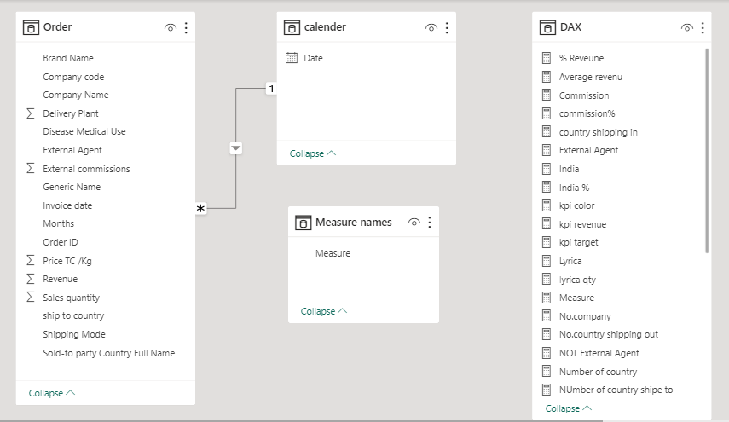
Fact table
4
DATA MODELING

Slide 11
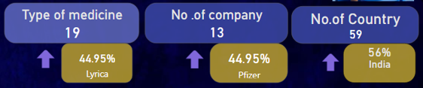


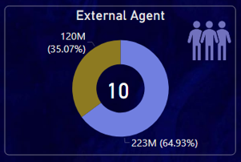
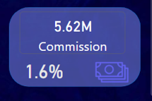
OVERVIEW INSIGHTS
The highest quantity of medicine by lyrica about 45 % of total order in warehouse .
The highest company we took orders from it is pfizer it represent about 45% .
the highest country that orderd medicine is india , it s order represent 56% form total order .
there are 10 external agent .
The commission that came out from company is 5.63 M , it represent about 1.6% from total revenue .

Slide 12
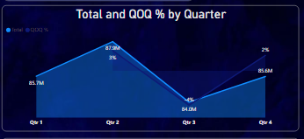
FINANCE INSIGHT
Total revenue is 343.15 M
193 M
This charts indicates that the highest revanue by brand name is Lyrica its revenue 193 M ,that significantly high revenue.
Lyrica
The revenu rate in the Qtr_1 was 85M
The revenu rate in the Qtr_2 was 87M this Qtr the warehouse achived the target ,that was 4% higher than required about 1.5%.
The revenu rate in the Qtr_3 was 84M, that is the least performance of warehouse, it decreased by -4 % .
The revenu rate in the Qtr_4 was 85M, it icreased by 2% .

Slide 13
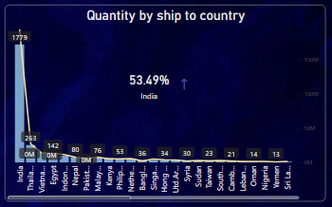
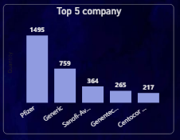
ORDER INSIGHTS
Total order is 3326 order
There are 19 type of medicine
The highest country that ordered medicine is india quantity 1779 about 53.5% from total order
ABOUT OUR FOUNDER
The highest company is pfizer that we taken orderes from it , about 1495 order
The top 5 company we depended on orders are pfizer ,generic , sanofi-aventis, genentec and centocor .

Slide 14


RECOMMENDATION
10
For more expantion we need to increse the external agent in countries
55%
of sales are for lyrica this suggests to increase the commission for anthor type

Slide 15

THANK YOU

